Slide 1
Introduction to deep learning
STAT 601.28 Week 2
Dr. Qingrun Zhang

Slide 2
Table of content
What is neural network?
Supervised Learning with Neural Network
Logistic regression in NN view
Loss functions
Parameters and Hyperparameters
Regularization in Neural Network

Slide 3


https://mashable.com/article/legalist-startup-lawsuit
Notes:
This is just one of the many applications of neural networks.

Slide 4
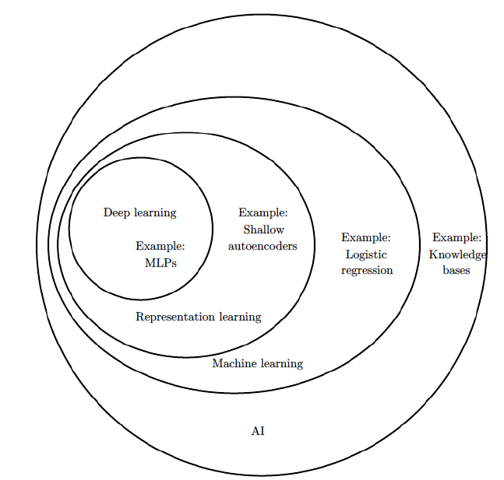

What is Neural Network
Neural Network
Notes:
Neural networks, also known as artificial neural networks (ANNs) or simulated neural networks (SNNs), are a subset of machine learning and are at the heart of deep learning algorithms. Their name and structure are inspired by the human brain, mimicking the way that biological neurons signal to one another.
Neural networks take in data train themselves to recognize the patterns in this data and then predict the outputs for a new set of similar data

Slide 5
Types of neural networks
The perceptron, the simplest NN, created by Frank Rosenblatt in 1958, has a single neuron
Feedforward neural networks, or multi-layer perceptrons (MLPs) are comprised of an input layer, a hidden layer or layers, and an output layer. they are actually comprised of sigmoid neurons.
Convolutional neural networks (CNNs) are utilized for image recognition, pattern recognition, and/or computer vision
Recurrent neural networks (RNNs) are identified by their feedback loops. These learning algorithms are primarily leveraged when using time-series data to make predictions about future outcomes,
https://www.ibm.com/cloud/learn/neural-networks
Notes:
Convolutional neural networks (CNNs) are similar to feedforward networks, but they’re usually utilized for image recognition, pattern recognition, and/or computer vision. These networks harness principles from linear algebra, particularly matrix multiplication, to identify patterns within an image.
Recurrent neural networks (RNNs) are identified by their feedback loops. These learning algorithms are primarily leveraged when using time-series data to make predictions about future outcomes, such as stock market predictions or sales forecasting.

Slide 6

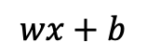
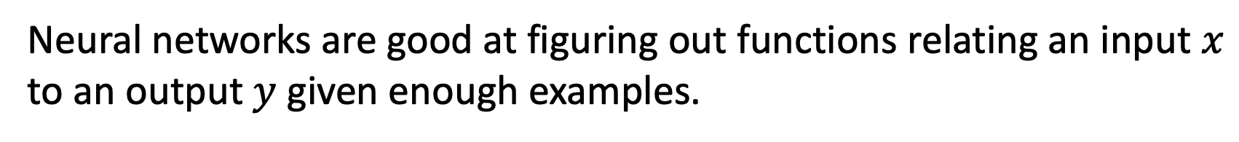

Condo Price Prediction
Neuron
Price
Size
$x$
$$wx+b$$
Price
$$y$$
∑
ƒ
Activation
function
Square feet of the Condo
Neural networks are good at figuring out functions relating an input $x$ to an output $y$ given enough examples.
Notes:
Let's start with a condo Price Prediction example. Let's say you have a data set with several condos, so you know the size of the condos in square feet and you know the price of the condo and you want to fit a function to predict the price of a condo as a function of its size. So if you are familiar with linear regression you might say, well let's put a straight line to this data, so, and we get a straight line like that. But to be a bit fancier, you might say, well we know that prices can never be negative, right? So instead of the straight line fit, which eventually will become negative, let's bend the curve here. So it just ends up zero here.
So this thick green line ends up being your function for predicting the price of the house as a function of its size. Where it is zero here and then there is a straight line fit to the right. So you can think of this function that you have just fit to housing prices as a very simple neural network. It is almost the simplest possible neural network.
We have as the input to the neural network the size of a condo which we call x. It goes into this node, this little circle and then it outputs the price which we call y.
So this little circle, which is a single neuron in a neural network

Slide 7
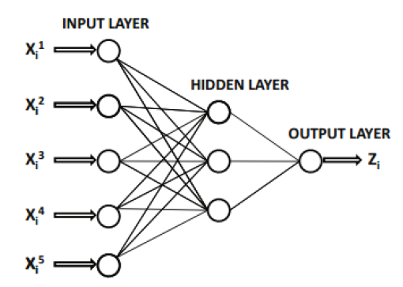

Size
#Bathroom
#bedroom
Price
y
School Quality
Walkability
x
Notes:
Let’s say that instead of predicting the price of a house just from the size, you now have other features. such as the number of bedrooms, the number of bathrooms,the walkability, the school quality. So each of these little circles can be one of those ReLU, rectified linear units or some other slightly non-linear function.
So in the example x is all of these five inputs. And y is the price you're trying to predict. By stacking together a few of the single neurons, we now have a slightly larger neural network. When build a neural network, you need to give it just the input x and the output y for a number of examples in your training set and all these things in the middle, they will figure out by itself. so given these input features, the job of the neural network will be to predict the price y. And notice also that each of these circles, these are called hidden units in the neural network, that each of them takes its inputs all five input features. So we say that layer that this is input layer and this layer in the middle of the neural network are densely connected. Because every input feature is connected to every one of these circles in the middle. And the remarkable thing about neural networks is that, given enough data about x and y, neural networks are remarkably good at figuring out functions that accurately map from x to y.

Slide 8
Supervised Learning with Neural Network
Input (X) | Output (Y) | Application
Housing features | Price | Real Estate | Standard NN
Ad, user info | Probability of click an ad | Online advertising | Standard NN
Image | Object | Photo Tagging | CNN
Audio | Text Transcript | Speech Recognition | RNN
Lawsuit features | Probability of success | Lawsuit | Customize Hybrid
Image, Radar info | Position of other objects | Autonomous driving | Customize Hybrid
Structured Data | Unstructured Data
Housing price | Audio
Advertising | image
 | text

Slide 9
Which of the following are examples of structured data?
A dataset with short poems
A dataset of weight, height, age, blood sugar level, and arterial pressure
A set of audio recordings of a person reading a sentence
A dataset with zip code, house price, house square feet, # of bathrooms, # of bedrooms.

Slide 10
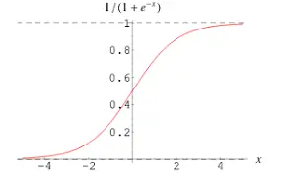
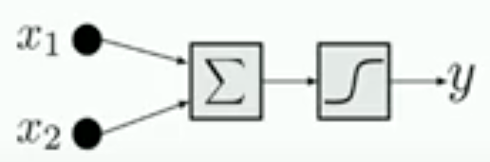
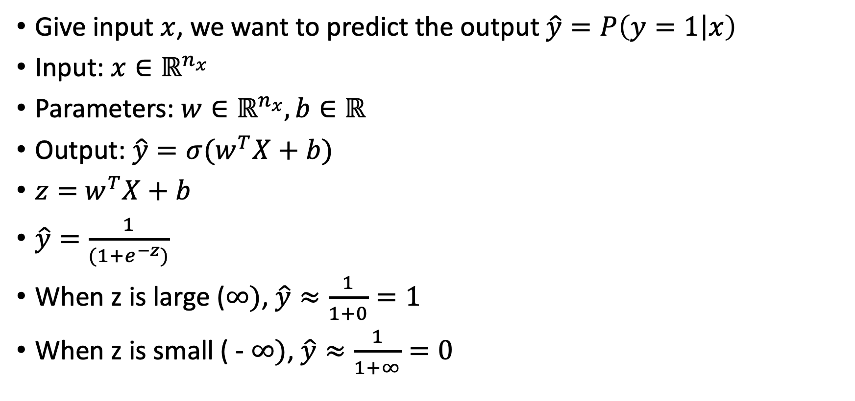
Binary classification – Logistic Regression
Give input $x$, we want to predict the output $\hat{y}=P\left(y=1 | x\right)$
Input: $x∈ℝ^{n_{x}}$
Parameters: $w∈ℝ^{n_{x}}, b∈ℝ$
Output: $\hat{y}=σ(w^{T}X+b)$
$z=$ $w^{T}X+b$
$\hat{y}=\frac{1}{(1+e^{−z})}$
When z is large ($∞)$, $\hat{y}≈\frac{1}{1+0}=1$
When z is small ( - $∞)$, $\hat{y}≈\frac{1}{1+∞}=0$
What are the parameters of logistic regression?
Notes:
logistic regression is a learning algorithm that you use when the output labels Y in a supervised learning, the output are binary.
so for binary classification problems. Given an input feature vector X maybe corresponding to a set of gene expression that you want to recognize weather a patient have diabetes or not,
you want an algorithm that can output a prediction, which we'll call Y hat, you want Y hat to be the probability of the chance that, Y is equal to one given the input features X. So in other words, if X a person’s genes’ expression, you want Y hat to tell you, what is the chance that this patient has diabites?
So X is an N_X dimensional vector, W which is also an N_X dimensional vector, together with b which is just a real number. So given an input X and the parameters W and b, how do we generate the output Y hat?
W transpose X plus B can be much bigger than one or it can even be negative, which doesn't make sense for probability. That you want p(y=1|x) to be between zero and one. So in logistic regression, the output is Y hat equals the sigmoid function applied to wx+b. This is what the sigmoid function looks like. the horizontal axis is Z, then the function sigmoid of Z looks like this. if Z is very large the sigmoid of Z is very close to one. Z becomes a very negative number, sigmoid of Z goes very close to zero. So when you implement logistic regression, your job is to try to learn parameters W and B so that Y hat becomes a good estimate of the chance of Y being equal to one.

Slide 11
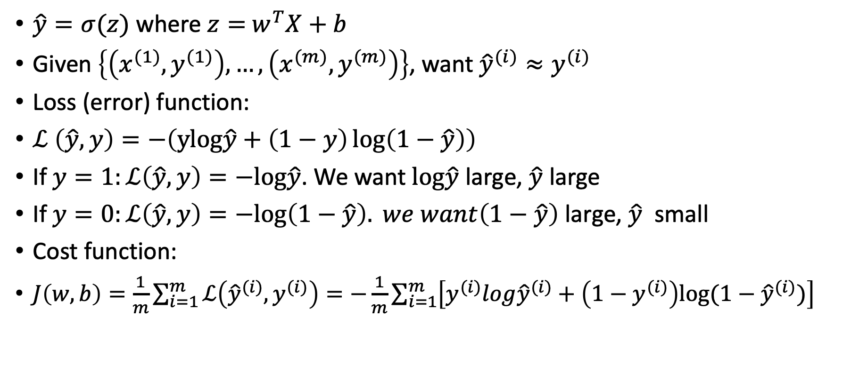
Logistic Regression cost function
$\hat{y}=σ(z)$ where $z=$ $w^{T}X+b$
Given $\left\{\left(x^{(1)},y^{(1)}\right),…,\left(x^{(m)},y^{(m)}\right)\right\}$, want ${\hat{y}}^{(i)}≈y^{(i)}$
Loss (error) function:
$ℒ \left(\hat{y},y\right)=−\left(ylog\hat{y}+\left(1−y\right)\log\left(1−\hat{y}\right)\right)$
If $y=1:ℒ\left(\hat{y},y\right)=−log\hat{y}$. We want $log\hat{y}$ large, $\hat{y}$ large
If $y=0:ℒ\left(\hat{y},y\right)=−log\left(1−\hat{y}\right). we want\left(1−\hat{y}\right)$ large, $\hat{y}$ small
Cost function:
$J\left(w,b\right)=\frac{1}{m}\sum_{i=1}^{m}{ℒ\left({\hat{y}}^{(i)},y^{(i)}\right)=−\frac{1}{m}\sum_{i=1}^{m}{\left[y^{(i)}log{\hat{y}}^{(i)}+\left(1−y^{(i)}\right)log⁡(1−{\hat{y}}^{(i)})\right]}}$

Slide 12
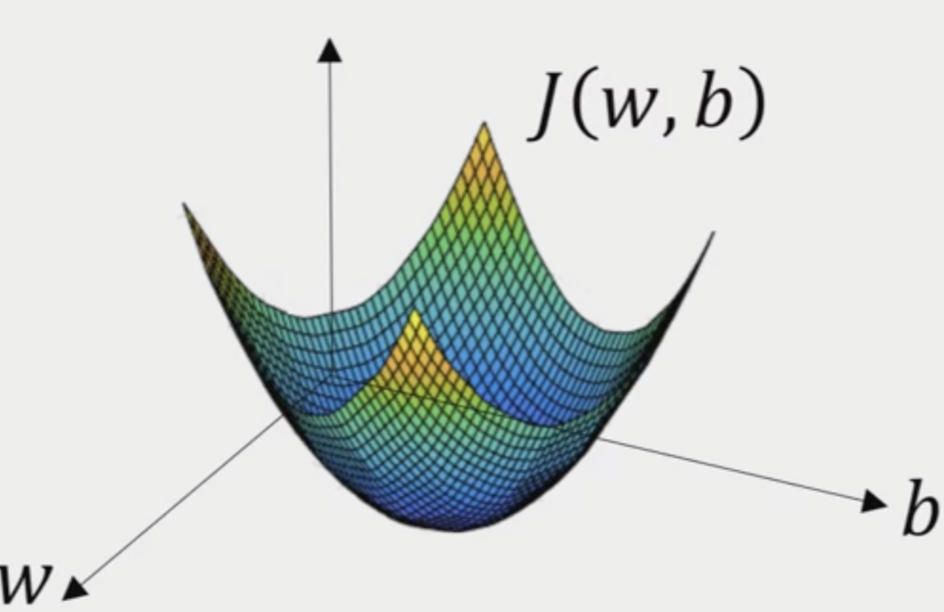
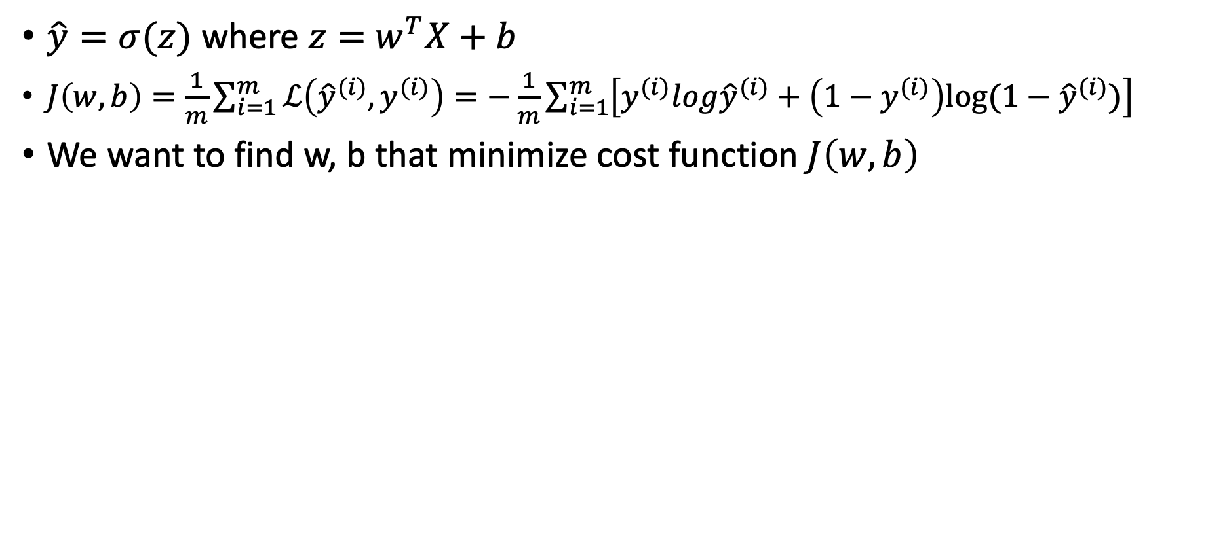
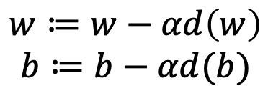
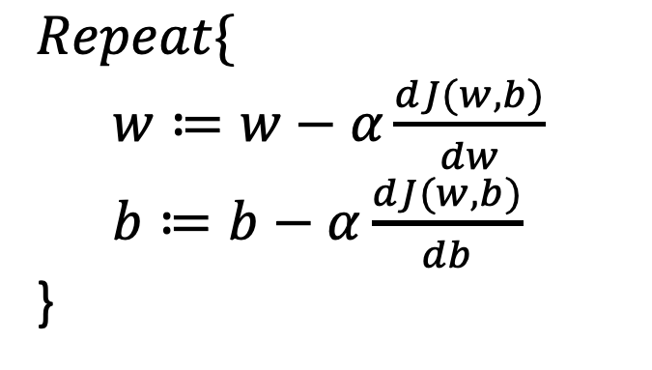
Gradient Descent
$\hat{y}=σ(z)$ where $z=$ $w^{T}X+b$
$J\left(w,b\right)=\frac{1}{m}\sum_{i=1}^{m}{ℒ\left({\hat{y}}^{(i)},y^{(i)}\right)=−\frac{1}{m}\sum_{i=1}^{m}{\left[y^{(i)}log{\hat{y}}^{(i)}+\left(1−y^{(i)}\right)log⁡(1−{\hat{y}}^{(i)})\right]}}$
We want to find w, b that minimize cost function $J\left(w,b\right)$
$$Repeat\{$$
$w≔w−α\frac{dJ(w,b)}{dw}$
$b≔b−$ $α\frac{dJ(w,b)}{db}$
}
$$w≔w−αd\left(w\right)$$
$$b≔b−αd(b)$$

Slide 13
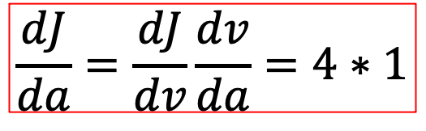
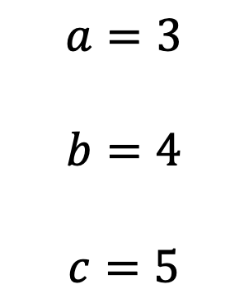
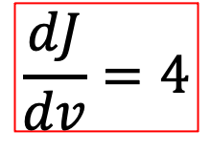
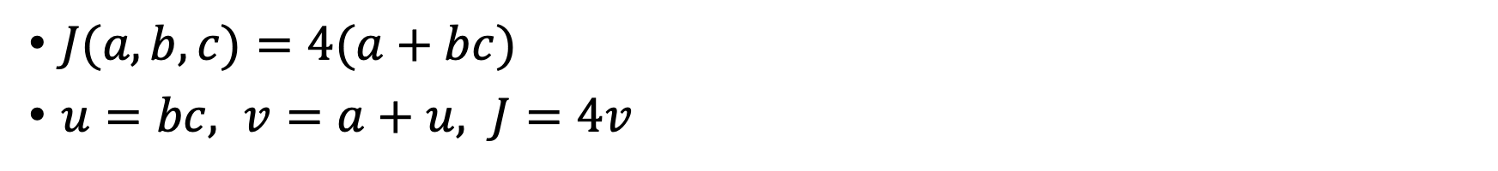
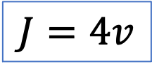
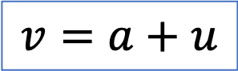
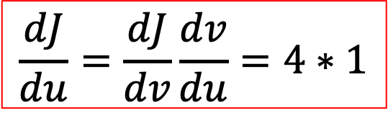
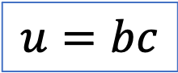
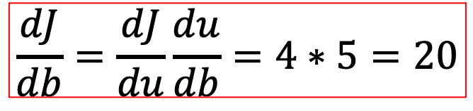
Computation graph
$J(a,b,c)=4(a+bc)$
$u=bc, v=a+u, J=4v$
Forward & backward
Propagation
$$\frac{dJ}{da}=\frac{dJ}{dv}\frac{dv}{da}=4∗1$$
$$a=3$$
$$b=4$$
$$c=5$$
23
92
20
$$v=a+u$$
$$J=4v$$
$$u=bc$$
$$\frac{dJ}{dv}=4$$
$$\frac{dJ}{du}=\frac{dJ}{dv}\frac{dv}{du}=4∗1$$
$$\frac{dJ}{db}=\frac{dJ}{du}\frac{du}{db}=4∗5=20$$

Slide 14
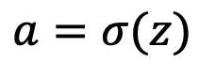
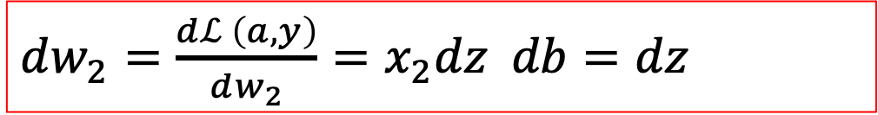
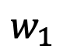
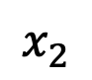
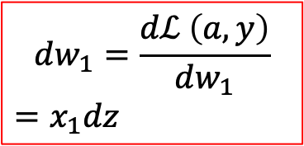
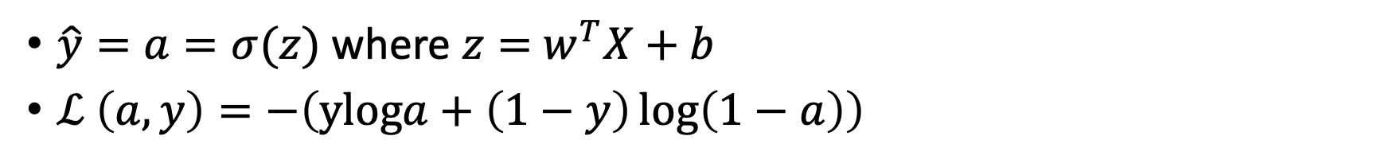
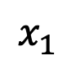
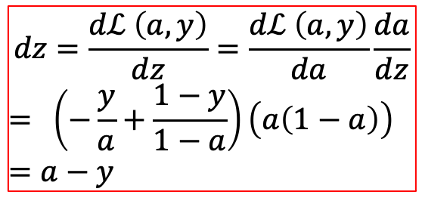
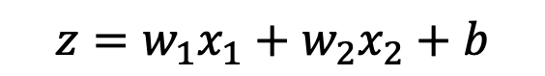
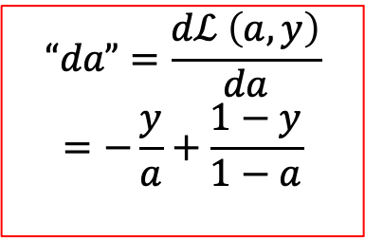
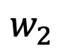
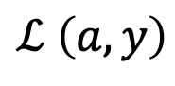
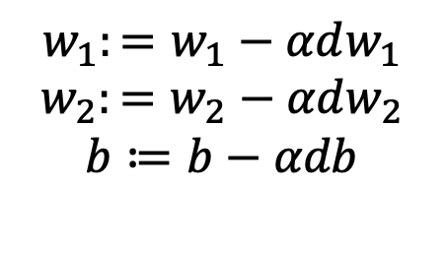
Logistic Regression Gradient Descent: 1 example
$\hat{y}=a=σ(z)$ where $z=$ $w^{T}X+b$
$ℒ \left(a,y\right)=−\left(yloga+\left(1−y\right)\log\left(1−a\right)\right)$
$$x_{1}$$
$$w_{1}$$
$$z=w_{1}x_{1}+w_{2}x_{2}+b$$
$$a=σ(z)$$
$$ℒ \left(a,y\right)$$
$$x_{2}$$
$$w_{2}$$
$$“da”=\frac{dℒ \left(a,y\right)}{da}$$
$$=−\frac{y}{a}+\frac{1−y}{1−a}$$
$$dz=\frac{dℒ \left(a,y\right)}{dz}=\frac{dℒ \left(a,y\right)}{da}\frac{da}{dz}$$
$$= \left(−\frac{y}{a}+\frac{1−y}{1−a}\right)\left(a\left(1−a\right)\right)$$
$$=a−y$$
$$dw_{1}=\frac{dℒ \left(a,y\right)}{dw_{1}}$$
$$=x_{1}dz$$
$$w_{1}:=w_{1}−αdw_{1}$$
$$w_{2}:=w_{2}−αdw_{2}$$
$$b≔b−αdb$$
$dw_{2}=\frac{dℒ \left(a,y\right)}{dw_{2}}=x_{2}dz db=dz$

Slide 15
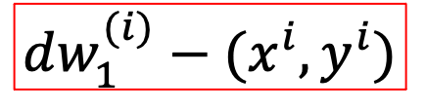
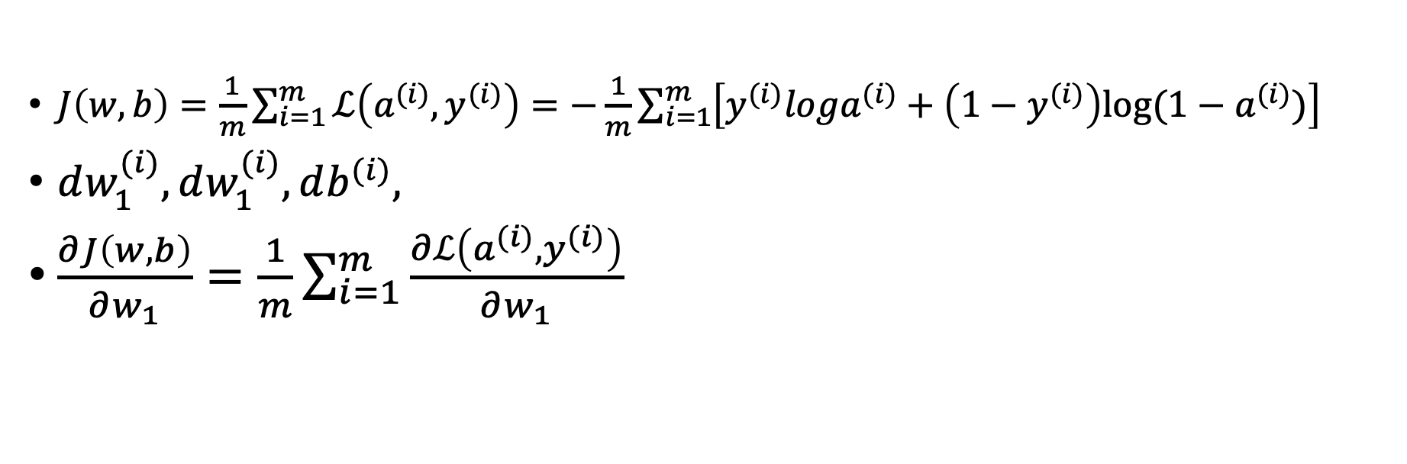
Logistic Regression on m examples
$J\left(w,b\right)=\frac{1}{m}\sum_{i=1}^{m}{ℒ\left(a^{(i)},y^{(i)}\right)=−\frac{1}{m}\sum_{i=1}^{m}{\left[y^{(i)}loga^{(i)}+\left(1−y^{(i)}\right)log⁡(1−a^{(i)})\right]}}$
$dw_{1}^{(i)},dw_{1}^{(i)},db^{(i)},$
$\frac{∂J\left(w,b\right)}{∂w_{1}}=\frac{1}{m}\sum_{i=1}^{m}{\frac{∂ℒ\left(a^{(i)},y^{(i)}\right)}{∂w_{1}}}$
$$dw_{1}^{(i)}−(x^{i},y^{i})$$

Slide 16
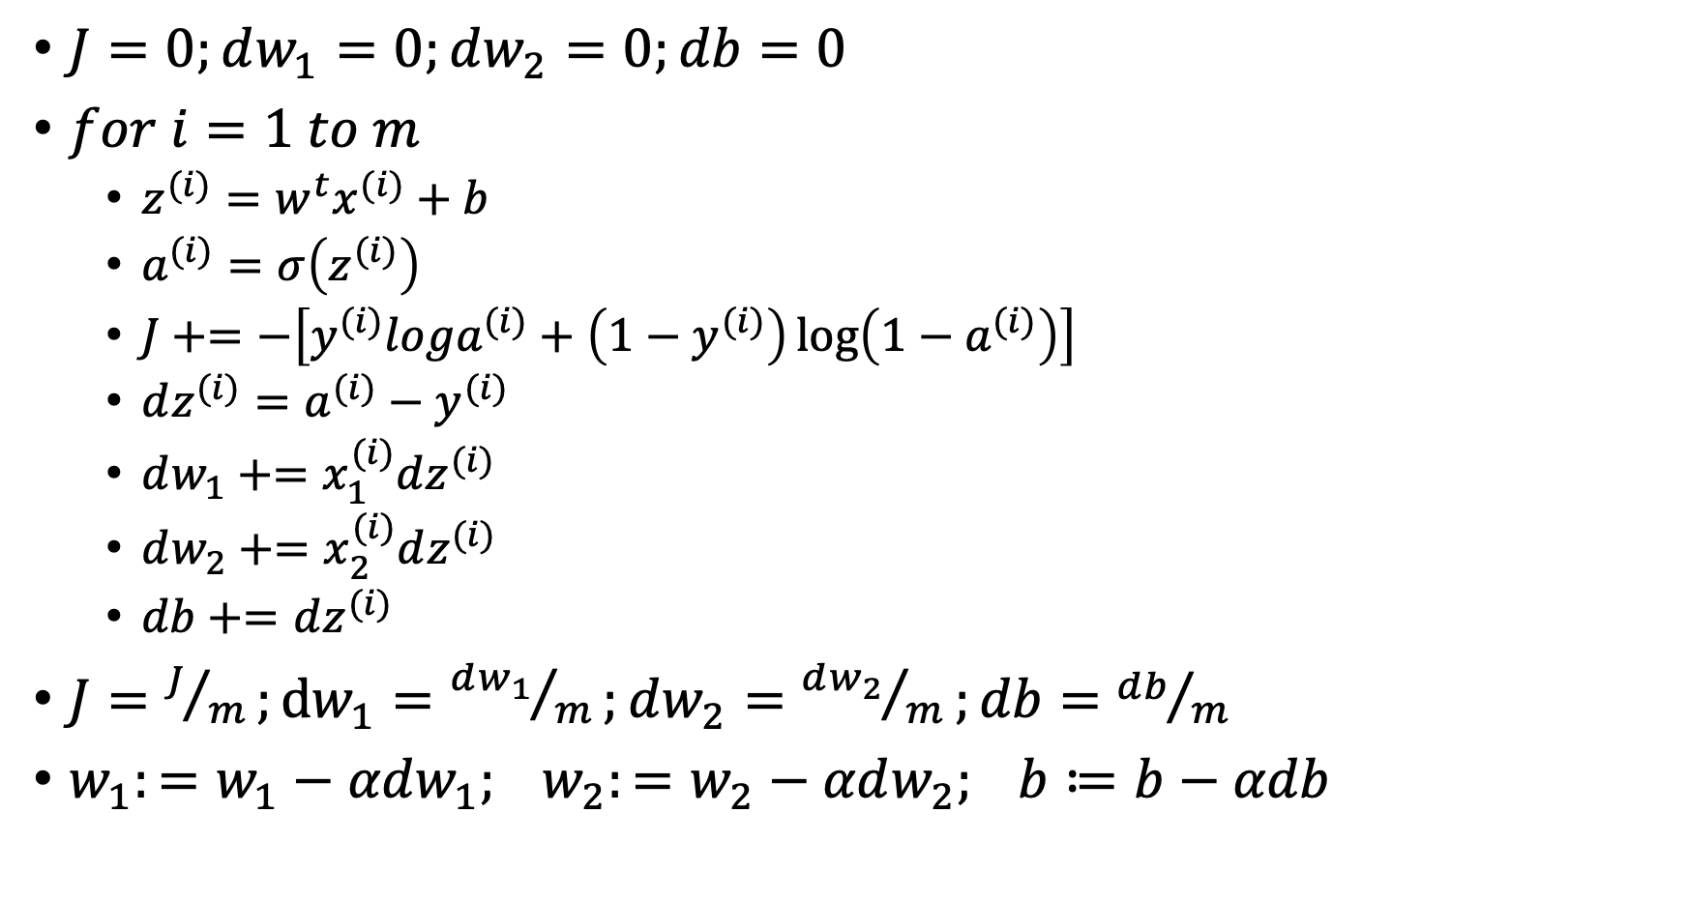
Logistic Regression on m examples
$J=0;dw_{1}=0;dw_{2}=0;db=0$
$for i=1 to m$
$z^{(i)}=w^{t}x^{(i)}+b$
$a^{(i)}=σ\left(z^{(i)}\right)$
$J+=−\left[y^{(i)}loga^{(i)}+\left(1−y^{(i)}\right)\log\left(1−a^{(i)}\right)\right]$
$dz^{(i)}=a^{(i)}−y^{(i)}$
$dw_{1}+=x_{1}^{(i)}dz^{(i)}$
$dw_{2}+=x_{2}^{(i)}dz^{(i)}$
$db+=dz^{(i)}$
$J=J/m;dw_{1}={dw_{1}}/m;dw_{2}={dw_{2}}/m;db={db}/m$
$w_{1}:=w_{1}−αdw_{1}; w_{2}:=w_{2}−αdw_{2}; b≔b−αdb$

Slide 17
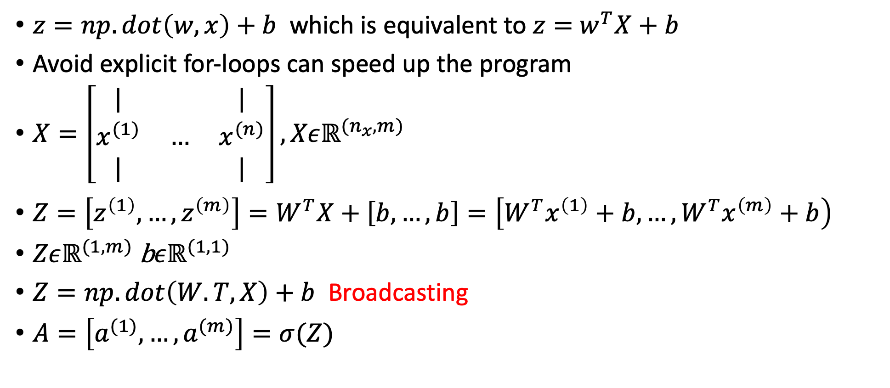
Vectorization
$z=np.dot\left(w,x\right)+b$ which is equivalent to $z=$ $w^{T}X+b$
Avoid explicit for-loops can speed up the program
$X=\left[\begin{matrix}| & & | \\ x^{(1)} & … & x^{(n)} \\ | & & |\end{matrix}\right], Xεℝ^{(n_{x},m)}$
$Z=\left[z^{\left(1\right)},…,z^{\left(m\right)}\right]=W^{T}X+\left[b,…,b\right]=\left[W^{T}x^{\left(1\right)}+b,…,W^{T}x^{\left(m\right)}+b\right)$
$Zεℝ^{(1, m)}$ b$εℝ^{(1, 1)}$
$Z=np.dot\left(W.T, X\right)+b$ Broadcasting
$A=\left[a^{(1)},…,a^{(m)}\right]=σ(Z)$

Slide 18
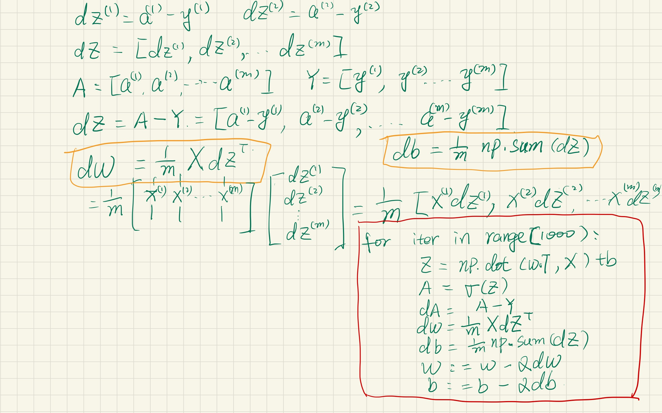

Slide 19
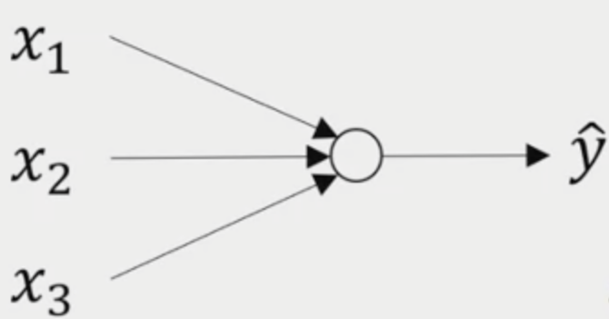
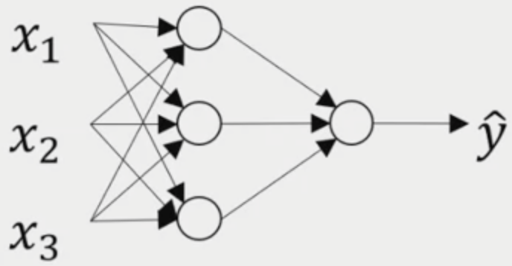
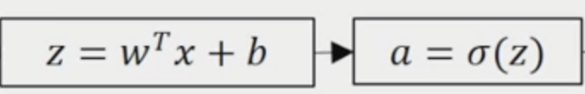
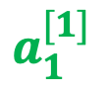
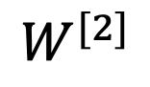
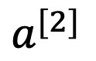
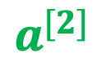
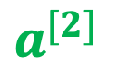
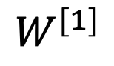
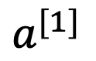
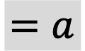



Review what is Neural Network?
Input Layer
Hidden Layer
Output Layer
$$a^{[0]}$$
$$a^{[1]}$$
$$a^{[2]}$$
$$=a$$
$$a_{1}^{[1]}$$
$$a_{2}^{[1]}$$
$$a^{[2]}$$
$$a^{[2]}$$
$$a_{3}^{[1]}$$
$$W^{[1]}$$
$$W^{[2]}$$

Slide 20



Layer index
Node in layer index

Slide 21


Slide 22


Slide 23


Slide 24


Slide 25





Logistic Regression
$$ℒ \left(a,y\right)=−\left(yloga+\left(1−y\right)\log\left(1−a\right)\right)$$
$$dz=\frac{dℒ \left(a,y\right)}{dz}=\frac{dℒ \left(a,y\right)}{da}\frac{da}{dz}$$
$$= \left(−\frac{y}{a}+\frac{1−y}{1−a}\right)\left(a\left(1−a\right)\right)$$
$$=a−y$$
$$“da”=\frac{dℒ \left(a,y\right)}{da}$$
$$=−\frac{y}{a}+\frac{1−y}{1−a}$$
$$dw=dz∗x$$
$$db=dz$$

Slide 26










Neural Network gradients
$$dz^{[1]}=w^{\left[2\right]T}dz^{\left[2\right]}∗g^{{\left[1\right]}^{′}}(z^{[1]})$$
$$“da”=\frac{dℒ \left(a,y\right)}{da}$$
$$=−\frac{y}{a}+\frac{1−y}{1−a}$$
$$dz^{[2]}=a^{[2]}−y$$
$${(n}^{[1},1)=n^{[1]},n^{[2]}\left(n^{[2]},n^{[1]}\right)∗(n^{\left[1\right]},1)$$
$$dw^{[2]}=dz^{[2]}a^{\left[1\right]T}$$
$$w^{[2]} (n^{[2]},n^{[1]})$$
$$db^{[2]}={dz}^{[2]}$$
$$z^{[2]} (n^{\left[2\right]},1)$$
$${dz}^{[2]} (1,1)$$

Slide 27


Forward and Backward propagation for layer $l$
Forward propagation:
Input $A^{[l−1]}$; output: $A^{\left[l\right],}cache(Z^{[l]})$
$Z^{[l]}=W^{[l]}A^{[l−1}+b^{[l]} A^{[l]}=g^{[l]}(Z^{[l]})$
Backward propagation:
Input: $dA^{[l]}$; output: $dA^{,[l]}, dW^{[l]}, db^{[l]}$
$dZ^{[l]}=dA^{[l]}∗g^{[l]}(Z^{[l]})$
$dW^{[l]}=\frac{1}{m}dZ^{[l]}A^{\left[l−1\right]T}$
$db^{[l]}=\frac{1}{m}np.sum\left(dZ^{[l]},axis=1, keepdims=True\right)$
$dA^{[l−1}=W^{\left[l\right]T}dZ^{[l]}$

Slide 28
Readings for Feedforward Neural Network
https://jonaslalin.com/2021/12/10/feedforward-neural-networks-part-1/
https://jonaslalin.com/2021/12/21/feedforward-neural-networks-part-2/
https://jonaslalin.com/2021/12/22/feedforward-neural-networks-part-3/

Slide 29
Homework

Slide 30
Loss functions
https://towardsdatascience.com/what-is-loss-function-1e2605aeb904

Slide 31

Parameters and Hyperparameters
Parameters:$W^{[l]},b^{[l]}$ Learning rate $α$
Hyperparameters:
# of iterations
# hidden layers l
# hidden units
Choice of Activation Function
Momentum,
Minibatch size
Regularization terms

Slide 32












$$dZ^{[2]}=A^{[2]}−Y$$
$$dz^{[2]}=a^{[2]}−y$$
$$dW^{[2]}=\frac{1}{m}dZ^{[2]}A^{\left[1\right]T}$$
$$dw^{[2]}=dz^{[2]}a^{\left[1\right]T}$$
$$db^{[2]}={\frac{1}{m}np.sum(dz}^{[2]}, axis=1, keepdims=True)$$
$$db^{[2]}={dz}^{[2]}$$
$$dz^{[1]}=w^{\left[2\right]T}dz^{\left[2\right]}∗g^{{\left[1\right]}^{′}}(z^{[1]})$$
$$dz^{[1]}=w^{\left[2\right]T}dz^{\left[2\right]}∗g^{{\left[1\right]}^{′}}(z^{[1]})$$
$$dw^{[1]}={dz}^{[1]}x^{T}$$
$$dw^{[1]}={dz}^{[1]}x^{T}$$
$$db^{[1]}={dz}^{[1]}$$
$$db^{[1]}={dz}^{[1]}$$

Slide 33







Weight initialization
It is ok to initialize b to zero, but w should be randomly initialized to prevent the symmetric issue.
$$w=\left[\begin{matrix}0 & 0 \\ 0 & 0\end{matrix}\right]$$
$$a_{1}^{[1]}=a_{2}^{[1]}$$
$$w^{[1]}=np.randome.rand\left(n^{[2]},n^{[1]}\right)∗0.01$$
$$z^{[1]}=w^{[1]}x+b^{[1]}$$
$$b^{[1]}=np.zeros\left(n^{[1]},1\right)∗0.01$$
Big z makes learning rate small
$$a^{[1]}=g^{\left[1\right]}(z^{\left[1\right]})$$

Slide 34





$$\# of layers=\# of hidden layer+output layer$$
4 hidden layers
Layer
Sample
Notations in DL
$$\begin{matrix}x_{1}^{(2)} \\ x_{2}^{(2)} \\ x_{n}^{(2)}\end{matrix}$$
$$a_{i}^{[1](2)}=g^{\left[1\right]}(z_{i}^{[1]})$$
$$w_{ij}^{[1]}$$
$$b_{i}^{[1]}$$
Vectorize version
by yourself
Nodes
Feature
Notes:
Deep neural networks can learn that shallower models are often unable to

Slide 35






$$w^{[l]} dimension (n^{[l]},n^{[l−1]})$$
$${dw}^{[l]} dimension (n^{[l]},n^{[l−1]})$$
$$b^{[l]} dimension (n^{\left[l\right]},1)$$
$$w$$
$$z^{[1]} =w^{[1]}x+b^{[1]}$$
(3,1) (3,4)(4,1) (3,1)
$$Z^{[1]} =W^{[1]}x+b^{[1]}$$
(3,m) (3,4)(4,m) (3,1)

Slide 36

Google colab
https://www.youtube.com/watch?v=inN8seMm7UI

Slide 37

TensorFlow
https://www.tensorflow.org/api_docs/python/tf

Slide 38
TensorFlow Datasets
https://colab.research.google.com/drive/1WcGPtBYeaHqFPcqeqoS9Rz-9bhzPzT5I#scrollTo=5RIpCzxysonU
https://colab.research.google.com/drive/17TTGCcQzSL76KHkBwbSroVMbmdR9orlt

Slide 39
ML is a highly iterative process
# layers
# hidden units
Learning rates
Activation functions
Regularization
….
Idea
Code
Experiment

Slide 40
Train/Dev/Test datasets
Training set
CV/Dev set
Test set
Training set to train your models
Cross Validation/Development Set to evaluate which model works the best
Test set to estimate of how well the model is doing
Common practice 60/20/20 percentage for each set (when total data point less than 10K )
In big data era, for example 1M example, 10K for Dev and 10K for test is enough 98/1/1

Slide 41
Mismatched train/test distribution
When we have mismatched train and test set, for example, different image quality for train and test set, the thumb of rule is to make sure Dev and train set should come from the same distribution.
Sometimes it is OK of not having test set, only Dev set is fine

Slide 42

Bias and Variance
High Bias
High Variance
Just right
https://livebook.manning.com/book/machine-learning-for-mortals-mere-and-otherwise/chapter-11/21
Notes:
Let's see the data set that looks like this.
If you fit a straight line to the data,
maybe get a logistic regression fit to that.
This is not a very good fit to the data,
and so this is a class of high bias.
So we say that this is underfitting the data.
On the opposite end,
if you fit an incredibly complex classifier,
maybe a deep neural network,
or a neural network with all the hidden units,
maybe you can fit the data perfectly,
but that doesn't look like a great fit either.
So there's a classifier of high variance and this is overfitting the data.
And there might be some classifier in between,
with a medium level of complexity,
that, you know, maybe fits the curve like that.
That looks like a much more reasonable fit to the data,
so we call that, you know, just right. It's somewhere in between.

Slide 43
Bias and Variance
Picture classification: Cat or Dog. Human optimal error is close to 0%
Training set error | 1% | 20% | 0.5% | 10%
Dev set error | 10% | 21% | 1% | 20%
 | High variance | High bias | Low bias Low variance | High bias High variance
Notes:
the takeaway is that by looking at your training set error, you can get a sense of how well you are fitting,
at least the training data, and so that tells you if you have a bias problem.
And then looking at how much higher your error goes, when you go from the training set to the dev set,
that should give you a sense of how bad is the variance problem. So you're doing a good job generalizing from a training set to the dev set, that gives you a sense of your variance.
All this is under the assumption that the Bayes error is quite small and that your training and your dev sets are drawn from the same distribution. If those assumptions are violated, there's a more sophisticated analysis you could do

Slide 44
High Bias? Training performance
Yes
Bigger Network
Train longer
Different NN architecture
No
High Variance?
Dev performance
Get more data
Regularization
NN architecture
Yes
No
Done
Notes:
But, back in the pre-deep learning era, we didn't have many tools, we didn't have as many tools that just reduce
bias, or that just reduce variance without hurting the other one. But in the modern deep learning, big data era,
so long as you can keep training a bigger network, and so long as you can keep getting more data, which isn't always the case for either of these, but if that's the case then getting a bigger network almost always just reduces your bias, without necessarily hurting your variance, so long as you regularize appropriately. And getting more data, pretty much always reduces your variance and doesn't hurt your bias much.

Slide 45



Regularization
$$λ is the regularization parameter$$
$\min_{w,b}{J(w,b)}$
$J\left(w,b\right)=\frac{1}{m}\sum_{i=1}^{m}{ℒ({\hat{y}}^{\left(i\right)},y^{(i)})}+\frac{λ}{2m}{\left\|w\right\|}_{2}^{2}$
L1 regularization: $\frac{λ}{2m}\sum_{j=1}^{n_{x}}{\left\|w\right\|}$
L1 regularization w will be sparse
L2 regularization:
${\frac{λ}{2m}\left\|w\right\|}_{2}^{2}=\sum_{j=1}^{n_{x}}{w_{j}^{2}=w^{T}w}$

Slide 46



Regularization in Neural Network
$J\left(w,b\right)=\frac{1}{m}\sum_{i=1}^{m}{ℒ({\hat{y}}^{\left(i\right)},y^{(i)})}+\frac{λ}{2m}\sum_{l=1}^{L}{{\left\|w^{[l]}\right\|}_{2}^{2}}$
Frobenius Norm
Notes:
In a neural network, you have a cost function that's a function of all of your parameters, w[1], b[1] through w[capital L], b[capital L], where capital L is the number of layers in your neural network. And so the cost function is this, sum of the losses, sum over your m training examples. And so to add regularization, you add lambda over 2m, of sum over all of your parameters w, your parameter matrix is w, of their, that's called the squared norm. Where, this norm of a matrix, really the squared norm, is defined as the sum of i, sum of j, of each of the elements of that matrix, squared. And if you want the indices of this summation, this is sum from i=1 through n[l minus 1]. Sum from j=1 through n[l], because w is a n[l] by n[l minus 1] dimensional matrix, where these are the number of hidden units or number of units in layers [l minus 1] in layer l. So this matrix norm, it turns out is called the Frobenius norm of the matrix, denoted with a F in the subscript. So for arcane linear algebra technical reasons, this is not called the, you know, l2 norm of a matrix. Instead, it's called the Frobenius norm of a matrix. I know it sounds like it would be more natural to just call the l2 norm of the matrix, but for really arcane reasons that you don't need to know, by convention, this is called the Frobenius norm. It just means the sum of square of elements of a matrix. So how do you implement gradient descent with this?

Slide 47

$dw^{[l]}=\frac{∂J}{∂w^{[l]}}$
$w^{[l]}=w^{[l]}−α{dw}^{[l]}$
With regularization term
$dw^{[l]}=\frac{∂J}{∂w^{[l]}}+\frac{λ}{2m}w^{[l]}$
$w^{[l]}=w^{[l]}−α(\frac{∂J}{∂w^{\left[l\right]}}+\frac{λ}{2m}w^{\left[l\right]})$
$w^{[l]}=w^{[l]}−α\frac{λ}{2m}w^{\left[l\right]}−α\frac{∂J}{∂w^{\left[l\right]}}$
Weight decay
Notes:
Previously, we would complete dw, you know, using backprop, where backprop would give us the partial derivative of J with respect to w, or really w for any given [l]. And then you update w[l], as w[l] minus the learning rate, times d. So this is before we added this extra regularization term to the objective. Now that we've added this regularization term to the objective, what you do is you take dw and you add to it, lambda over m times w. And then you just compute this update, same as before. And it turns out that with this new definition of dw[l], this is still, you know, this new dw[l] is still a correct definition of the derivative of your cost function, with respect to your parameters, now that you've added the extra regularization term at the end.
for this reason that L2 regularization is sometimes also called weight decay

Slide 48

Why regularization prevent overfitting?
$J\left(w,b\right)=\frac{1}{m}\sum_{i=1}^{m}{ℒ({\hat{y}}^{\left(i\right)},y^{(i)})}+\frac{λ}{2m}\sum_{l=1}^{L}{{\left\|w^{[l]}\right\|}_{2}^{2}}$
When $λ$is big, which will force $w^{[l]}≈0,$ when $w^{[l]}≈0$ which means the complicated model will get simplified, make it closer to linear model
$Z^{[l]}=W^{[l]}A^{[l−1}+b^{[l]}$
When $w^{[l]}≈0$, $Z^{[l]}$ is more likely
Fall in the range where the sigmoid
or tanh function at the linear
part

Slide 49

Dropout regularization
0.5
0.8

Slide 50

implement dropout
Layer 2, keep-prob=0.6
d2=np.random.rand(A2.shape[0], A2.shape[1])<keep-prob
D2 will be a Boolean array
A^{[2]}=np.multiply(A^{[2]}, d2) #elementwise multiplication
A^{[2]}/=keep-prob (Inverted dropout ) to maintain the expected value
$Z^{[3]}=W^{[3]}A^{[2]}+b^{[3]}$
A^{[2]} reduced by 40%, so we use A^{[2]}/=keep-prob to bump back
At test time, we don’t use dropout.

Slide 51
Why does dropout work?
Random knockout units in the network, the network is getting smaller.
With dropout, the inputs get randomly eliminated, it can’t rely on any one feature, so have to spread out weights, which will shrink the squared norm of the weight, similar to L₂ regularization
Different layer can have different keep-prob.
Computer vision input size is very big that you almost never have enough data, so dropout is widely used by computer vision. But not neccessary other type of data.

Slide 52

Data augmentation
https://nanonets.com/blog/data-augmentation-how-to-use-deep-learning-when-you-have-limited-data-part-2/
Notes:
In addition to L2 regularization and drop out regularization there are few other techniques to reducing over fitting in your neural network. Let's take a look. Let's say you fitting a Cat classifier. If you are over fitting. getting more training data can help, but getting more training data can be expensive and sometimes you just can't get more data. But what you can do is augment your training set by flipping, rotating or zooming into the image etc. By random distortions and translations of the image you could augment your data set and make additional fake training examples. Data augmentation isn't as good as if you had collected an additional set of brand-new independent examples. But you could do this almost for free to enlarge your data. This can be an inexpensive way to give your algorithm more data and therefore sort of regularize it and reduce over fitting.

Slide 53

Another approach: early stopping
Philosophy: Stop if we may on a wrong way!
Assumption: we have an independent dataset
Dev set error
Training error
# of iteration
Notes:
Early stopping is another regularization technique. So what you're going to do is as you run gradient descent you're going to plot the training error, Or just plot the cost function and that should decrease monotonically. with early stopping, what you do is you plot this, and you also plot your dev set error.what you find is that your dev set error will usually go down for a while, and then it will increase from there. So what early stopping does is, it helps you find the neural network was doing best for the dev set, so we just want to stop training on the neural network halfway and take whatever value achieved this dev set error. the term early stopping refers to the fact that you're just stopping the training of your neural network earlier.

Slide 54

Early stopping: an example
Notes:
it does have one downside, you want an algorithm to optimize the cost function j and after optimizing the cost function j, you also wanted to not over-fit. we already have so many hyper-parameters it surge over. It's already very complicated to choose among the space of possible algorithms. when you're focusing on authorizing the cost function J. All you care about is finding w and b, so that J(w,b) is as small as possible. it's completely separate task to not over fit, in other words, to reduce variance. the main downside of early stopping is that this couples these two tasks. So you no longer can work on these two problems independently, because by stopping gradient decent early, you're sort of breaking whatever you're doing to optimize cost function J, because now you're not doing a great job reducing the cost function J. You've sort of not done that that well. And then you also simultaneously trying to not over fit. So instead of using different tools to solve the two problems, you're using one that kind of mixes the two.
Rather than using early stopping, one alternative is just use L2 regularization then you can just train the neural network as long as possible. I find that this makes the search space of hyper parameters easier to decompose, and easier to search over. But the downside of this though is that you might have to try a lot of values of the regularization parameter lambda. And so this makes searching over many values of lambda more computationally expensive. And the advantage of early stopping is that running the gradient descent process just once, you get to try out values of small w, mid-size w, and large w, without needing to try a lot of values of the L2 regularization hyperparameter lambda. early stopping does let you get a similar effect without needing to explicitly try lots of different values of lambda.

Slide 55







X₂
Original
normalize your inputs
X₁
Subtract mean $μ=\frac{1}{m}\sum_{i=1}^{m}{x^{(i)}, x=x−μ}$
X₂
X₁
Normalize variances $σ^{2}=\frac{1}{m}\sum_{i=1}^{m}{x^{(i)}∗∗2}$
X₂
$$x=x/σ$$
X₁
Notes:
When training a neural network, one of the techniques to speed up your training is if you normalize your inputs. Let's see the training sets with two input features. The input features x are two-dimensional and here's a scatter plot of your training set. Normalizing your inputs corresponds to two steps, the first is to subtract out or to zero out the mean, the second step is to normalize the variances. Notice here that the feature x_1 has a much larger variance than the feature x_2 here. What we do is set sigma equals 1 over m sum of x_i star, star 2. this is element-y squaring. Now sigma squared is a vector with the variances of each of the features. Notice we've already subtracted out the mean, so x_i squared, element-y square is just the variances. You take each example and divide it by this vector sigma. One tip. If you use this to scale your training data, then use the same mu and sigma to normalize your test set. In particular, you don't want to normalize the training set and a test set differently. you scale your test set in exactly the same way rather than estimating mu and sigma squared separately on your training set and test set, because you want your data both training and test examples to go through the same transformation defined by the same Mu and Sigma squared calculated on your training data.
Why do we do this? Why do we want to normalize the input features? if you use unnormalized input features, it's more likely that the contours of cost function will look like this, like a very squished out bar, very elongated cost function where the minimum you're trying to find is maybe over there. But if your features are on very different scales, say the feature x_1 ranges from 1-1,000 and the feature x_2 ranges from 0-3, for example, square feet of a house and number of bath rooms in a house, then it turns out that the ratio or the range of values for the parameters w_1 and w_2 will end up taking on very different values. Whereas if you normalize the features, then your cost function will on average look more symmetric. If you are running gradient descent on a cost function for not normalized data, you might have to use a very small learning rate, the gradient decent might need a lot of steps to oscillate back and forth before it finally finds its way to the minimum. Whereas if you have more spherical contours, then wherever you start, gradient descent can pretty much go straight to the minimum. You can take much larger steps where gradient descent need, rather than needing to oscillate around .Of course, in practice, w is a high dimensional vector. Trying to plot this in 2D doesn't convey all the intuitions correctly. But the rough intuition that you cost function will be in a more round and easier to optimize when you're features are on similar scales. That just makes your cost function j easier and faster to optimize

Slide 56

Vanishing and exploding gradients
https://www.analyticsvidhya.com/blog/2021/06/the-challenge-of-vanishing-exploding-gradients-in-deep-neural-networks/
Notes:
The vanishing gradient problem describes a situation encountered in the training of neural networks where the gradients used to update the weights shrink exponentially. As a consequence, the weights are not updated anymore, and learning stalls.
The exploding gradient problem describes a situation in the training of neural networks where the gradients used to update the weights grow exponentially. This prevents the backpropagation algorithm from making reasonable updates to the weights, and learning becomes unstable.

Slide 57

Vanishing and exploding gradients
$a^{[1]}=g^{\left[1\right]}\left(w^{[1]}a^{\left[0\right]}+b\right),a^{[2]}=g^{\left[2\right]}\left({w^{[2]}a}^{\left[1\right]}+b\right)….$
$a^{[n]}=g^{\left[n\right]}(g^{\left[n−1\right]}…..g^{\left[1\right]}\left({w^{[1]}a}^{\left[0\right]}+b\right)…)$
For simplicity: the activation function for each layer are the same linear function, ignore the bias terms:
$w^{[1]}a^{\left[0\right]}→{w^{[2]}w}^{[1]}→…→{w^{[n]}…w}^{[1]}a^{\left[0\right]}$
Further simplify: $w^{n}a^{[0]}$
With very deep network (large n), when $w>1$ (e.g. ${1.5}^{16}=656.84)$ we get exploding weight. When $w>1$ (e.g. ${0.5}^{15}=3.05e−05)$, we get vanishing weight
Notes:
Every weight is actually a matrix of weights that is randomly initialized. A common procedure for weight initialization is to draw the weights randomly from a Gaussian distribution with mean 0 and variance 1. This means roughly 2/3 of the weights will have absolute values smaller than 1 while 1/3 will be larger than 1. In summary, the further your values are from 1 or 0, the more quickly you run into either vanishing or exploding gradients when you have long computational graphs, such as in deep neural networks.

Slide 58

Vanishing and exploding gradients- backward
$z^{[1]}=w^{[1]}x→a^{[1]}=σ\left(z^{\left[1\right]}\right)→z^{[2]}=w^{[2]}a^{[1]}→\hat{y}=σ\left(z^{\left[2\right]}\right)→J=\frac{1}{m}\sum_{i=1}^{m}{ℒ(\hat{y},y)}$
$J=\frac{1}{m}\sum_{i=1}^{m}{ℒ(\hat{y},y)}→\frac{∂J}{∂w^{[2]}}→\frac{∂J}{∂w^{[1]}}$
$\frac{∂J}{∂w^{[2]}}=\frac{∂J}{∂\hat{y}}\frac{∂\hat{y}}{∂z^{2}}\frac{∂z^{2}}{∂w^{2}}=\left(\frac{y}{\hat{y}}+\frac{1−y}{1−\hat{y}}\right)\left[σ\left(z^{[2]}\right)\left(1−σ\left(z^{[2]}\right)\right)\right]a^{[1]}$
$\frac{∂\hat{y}}{∂z^{2}}=σ\left(z^{[2]}\right)\left(1−σ\left(z^{[2]}\right)\right)=\frac{1}{1+e^{z^{2}}}\left(1−\frac{1}{1+e^{z^{2}}}\right), when z^{2}$=5, $\frac{∂\hat{y}}{∂z^{2}}≈0.0066$
$\frac{∂J}{∂w^{[1]}}=\frac{∂J}{∂\hat{y}}\frac{∂\hat{y}}{∂z^{2}}\frac{∂z^{2}}{∂a^{1}}$ $\frac{∂a^{1}}{∂z^{1}}$ $\frac{∂z^{1}}{∂w^{1}}$
Notes:
Vanishing – As the backpropagation algorithm advances downwards(or backward) from the output layer towards the input layer, the gradients often get smaller and smaller and approach zero which eventually leaves the weights of the initial or lower layers nearly unchanged. As a result, the gradient descent never converges to the optimum. This is known as the vanishing gradients problem.
Exploding – On the contrary, in some cases, the gradients keep on getting larger and larger as the backpropagation algorithm progresses. This, in turn, causes very large weight updates and causes the gradient descent to diverge. This is known as the exploding gradients problem.

Slide 59

Why do the gradients vanish/explode?
Larger inputs (negative or positive), it saturates at 0 or 1 with a derivative very close to zero.
https://www.analyticsvidhya.com/blog/2021/06/the-challenge-of-vanishing-exploding-gradients-in-deep-neural-networks/
Notes:
Certain activation functions, like the logistic function (sigmoid), have a very huge difference between the variance of their inputs and the outputs. In simpler words, they shrink and transform a larger input space into a smaller output space that lies between the range of [0,1].
Observing the above graph of the Sigmoid function, we can see that for larger inputs (negative or positive), it saturates at 0 or 1 with a derivative very close to zero. Thus, when the backpropagation algorithm chips in, it virtually has no gradients to propagate backward in the network, and whatever little residual gradients exist keeps on diluting as the algorithm progresses down through the top layers. So, this leaves nothing for the lower layers.
Similarly, in some cases suppose the initial weights assigned to the network generate some large loss. Now the gradients can accumulate during an update and result in very large gradients which eventually results in large updates to the network weights and leads to an unstable network. The parameters can sometimes become so large that they overflow and result in NaN values.

Slide 60
When is the model suffering from the gradient exploding/vanishing?
Exploding | Vanishing
There is an exponential growth in the model parameters | The parameters of the higher layers change significantly while the parameters of lower layers change very little
The model weights may become NaN during training | The model weights may become 0 during training
The model experiences avalanche learning | The model learns very slowly and perhaps the training stagnates at a very early stage just after a few iterations
https://www.analyticsvidhya.com/blog/2021/06/the-challenge-of-vanishing-exploding-gradients-in-deep-neural-networks/

Slide 61

Solutions for gradient exploding/vanishing
Proper Weight Initialization
The variance of outputs of each layer should be equal to the variance of its inputs.
The gradients should have equal variance before and after flowing through a layer in the reverse direction.
Xavier initialization or Glorot initialization
Normal distribution with mean 0 and variance σ² = 1/ fan_{avg}
Or a uniform distribution between -r and +r , with r = sqrt( 3 / fan_{avg} )
Notes:
Although it is impossible for both conditions to hold for any layer in the network until and unless the number of inputs to the layer ( fan_{in} ) is equal to the number of neurons in the layer ( fan_{out} ), but they proposed a well-proven compromise that works incredibly well in practice: randomly initialize the connection weights for each layer in the network as described in the following equation which is popularly known as Xavier initialization (after the author’s first name) or Glorot initialization (after his last name).

Slide 62

Solutions for gradient exploding/vanishing
Source: Hands-on Machine Learning with Scikit-Learn, Keras, and TensorFlow
Keras uses Xavier’s initialization strategy with uniform distribution by default, you can choose your own by
keras.layer.Dense(25, activation = "relu", kernel_initializer="he_normal") or
keras.layer.Dense(25, activation = "relu", kernel_initializer="he_uniform")
If we wish to use use the initialization based on fan_{avg} rather than fan_{in} , we can use the VarianceScaling initializer like this :
he_avg_init = keras.initializers.VarianceScaling(scale=2., mode='fan_avg', distribution='uniform’)
keras.layers.Dense(20, activation="sigmoid", kernel_initializer=he_avg_init)
https://www.analyticsvidhya.com/blog/2021/06/the-challenge-of-vanishing-exploding-gradients-in-deep-neural-networks/
Notes:
Here are some more very popular weight initialization strategies for different activation functions, they only differ by the scale of variance and by the usage of either fan_{avg} or fan_{in}

Slide 63
Solutions for gradient exploding/vanishing
Using Non-saturating Activation Functions
ReLU ( Rectified Linear Unit )
LReLU (Leaky ReLU)
Batch Normalization proposed by Sergey Ioffe and Christian Szegedy in 2015
Added batch normalization after each layer
This operation simply zero-centers and normalizes each input, then scales and shifts the result using two new parameter vectors per layer: one for scaling, the other for shifting.
keras.layers.BatchNormalization(),
Gradient Clipping: clip the gradients during backpropagation so that they never exceed some threshold.
optimizer = keras.optimizers.SGD(clipvalue = 1.0) # clip gradient to value from -1.0 to 1.0
optimizer = keras.optimizers.SGD(clipnorm = 1.0) # clip gradient and preserve its orientation
Source: https://www.analyticsvidhya.com/blog/2021/06/the-challenge-of-vanishing-exploding-gradients-in-deep-neural-networks/
Notes:
The orientation of the gradient vector may change due to this: for eg, let the original gradient vector be [0.9, 100.0] pointing mostly in the direction of the second axis, but once we clip it by some value, we get [0.9, 1.0] which now points somewhere around the diagonal between the two axes.
To ensure that the orientation remains intact even after clipping, we should clip by norm rather than by value.
Now the whole gradient will be clipped if the threshold we picked is less than its ℓ2 norm. For eg: if clipnorm=1 then the vector [0.9, 100.0] will be clipped to [0.00899, 0.999995] , thus preserving its orientation.

Slide 64








Gradient checking for neuro network
Compare numerical gradients with gradient from backpropagation (analytical)
Analytical derivative
Two-sided numerical derivative $Ο(ε^{2})$
Right-hand numerical derivative $Ο\left(ε\right)$
https://medium.com/towards-data-science/coding-neural-network-gradient-checking-5222544ccc64s
Notes:
we implemented both forward propagation and backpropagation in numpy. However, implementing backpropagation from scratch is usually more prune to bugs/errors. Therefore, it’s necessary before running the neural network on training data to check if our implementation of backpropagation is correct.
In back-propagation. we compute the derivative of cost function with respect to all parameters, i.e ∂J/∂θ where θ represents the parameters of the model.
Two-sided form of approximating the derivative is closer than the right-hand form. Let’s illustrate that with the following example using the function f(x) = x² by taking its derivative at x = 3.

Slide 65

How to do gradient checking?
Reshape $W^{[1]}{,b}^{[1]},…,W^{\left[L\right]},b^{[L[}$into a big vector $θ$
$J(W^{\left[1\right]}{,b}^{\left[1\right]},…,W^{\left[L\right]},b^{\left[L\right]}=J(θ$)
Reshape ${dW}^{[1]}{,db}^{[1]},…,{dW}^{\left[L\right]},{db}^{[L[}$into a big vector of $dθ$
For each i:
$dθ_{approx}\left[i\right]=\frac{J\left(θ_{1},θ_{2},…θ_{i}+ε, …\right)−J\left(θ_{1},θ_{2},…θ_{i}−ε, …\right)}{2ε}$
Check $\frac{{\left\|dθ_{approx}−dθ\right\|}_{2}}{{\left\|dθ_{approx}\right\|}_{2}+{\left\|dθ\right\|}_{2}}$, set $ε={10}^{−7}$

Slide 66

Gradient checking implementation notes
Don’t use in training, only to debug.
If the gradient check fails, check each components to identify bug.
If you use regularization term, don’t forget it when do gradient checking.
$J\left(w,b\right)=\frac{1}{m}\sum_{i=1}^{m}{ℒ({\hat{y}}^{\left(i\right)},y^{(i)})}+\frac{λ}{2m}\sum_{l=1}^{L}{{\left\|w^{[l]}\right\|}_{2}^{2}}$
Gradient checking doesn’t work with dropout.
In the case of dropout, first use dropout=1.0 (turn off dropout), using gradient checking to check backpropagation is correct, then turn on dropout

